Slide 1
AUTOMATIC FARE GENERATION SYSTEM FOR PARKING LOTS

Slide 2
Faculty Details:
Name: | Prof. Ajitha D
Designation: | Associate Professor Grade 1
Team Members List:
Name | Registration Number | Lab Slot
Arayan Kataria | 20BCE0658 | L43 + L44
Akshay Rai | 20BCE0617 | L39 + L40
Archit Jain | 20BCE0642 | L43 + L44
Ansh Bhatia | 20BCE0459 | L43 + L44
Niraj Kumar | 20BCE0034 | L43 + L44

Slide 3
AIM
In India, owing to a large population, car sales growth hikes every year. In the year 2017 itself, the growth was reported to be 9.2 percent, highest in past four years. This drives the need for strategizing methods for efficient systems that simplifies the management of these automobiles. One such domain are the Parking Lots at various locations across the country. Our project aims to provide an efficient and automatic fare generation system for parking lots that cater to multitudes of cars on a daily basis. The streets and areas that usually bustle with visitors every day require deployment of human sources to manage the parking of the visiting cars, calculate the estimated fares and collect the payment at the time of exit. This project will automate this procedure, thus eliminating the need to employ workers, preventing intentional over charging of fares for personal interests, providing an additional security measure in the form of image and database records, and improving the efficiency by reducing the human errors in the process. To implement this, the type of the vehicle and its identification, the license plate, are necessary to be determined by the system designed. This project engages Computer Vision and Machine Learning tools for the same.

Slide 4
Literature survey

Slide 5
S. No. | Paper Title | Name of the Journal, Year | Technology Used
1. | Comparison of Vehicle Detection Techniques applied to IP Camera Video Feeds for use in Intelligent Transport Systems | ELSEVIER, 2019 | YOLO, RetinaNet, Regional Based CNN
2. | Monitoring Multimodal Travel Environment Using Automated Fare Collection Data: Data Processing and Reliability Analysis | Springer, 2019 | Link Based Algorithm & Path Based Algorithm in Automatic Fare Collection(AFC)
3. | Public Traffic Congestion Estimation Using an Artificial Neural Network | MDPI, 2020 | Self Organizing MAP-SOM ( Artificial Neural Network )

Slide 6
S. No. | Paper Title | Name of the Journal, Year | Technology Used
4. | Intelligent System for Vehicles Number Plate Detection and Recognition Using Convolutional Neural Networks | MDPI, 2021 | CNN
5. | Vehicle Number Plate Detection and Recognition Techniques: A Review | The ASTE conference- organized by Threads, 2021 | Image Pre-processing, CNN
6. | Inferring flow patterns of subway passengers using a dynamic logistics model with automated fare collection and automated vehicle location data | SSRN, 2022 | Dynamic Logistic Model, EM Algorithm

Slide 7
GAP
License Plate Detection systems have been employed widely over the world for real time tracking of vehicles, curb criminal activities etc. Various techniques have been developed using different software's like LabView, MATLAB, OpenCV using different approaches like edge based, neural networks, sliding window techniques amongst others were used. While the initial edge based techniques didn’t produce accurate results, with no license plate detection or incorrect detection, the techniques developed later on which used median-filters and neural networks, though gave a better accuracy, but could only be used to detect English characters.

Slide 8
timeline
Review 1
Review 2
Review 3
Project title
Introduction
Problem Statement
System Requirement
Literature Survey
Feasibility analysis
References
Project Abstraction
Motivation
Proposed Solution
Demo
References
Introduction to our project(Product)
Detailed analysis
Advantages
Novelty
Application showcase (Project run)
References
Project documentation

Slide 9
BLOCK DIAGRAM

Slide 10
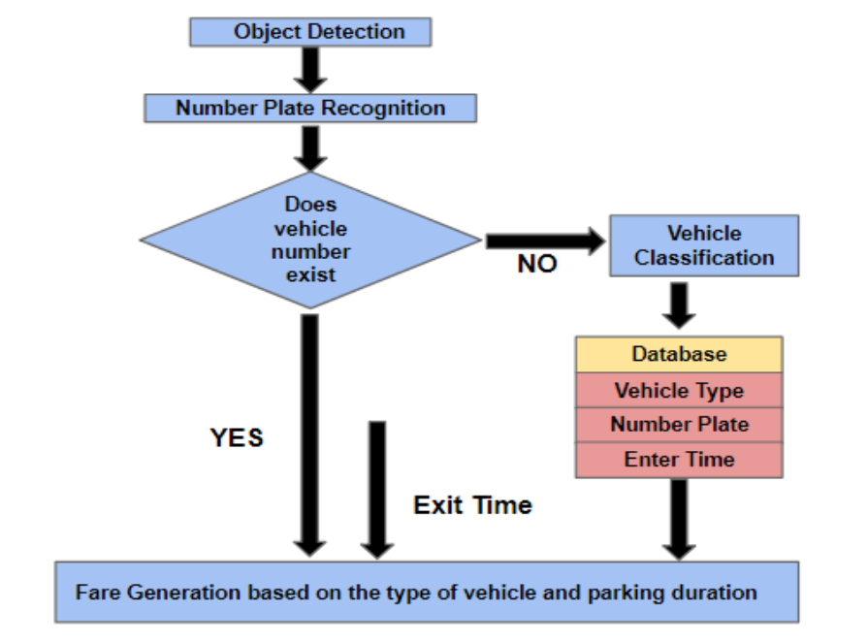

Slide 11
Hardware components

Slide 12
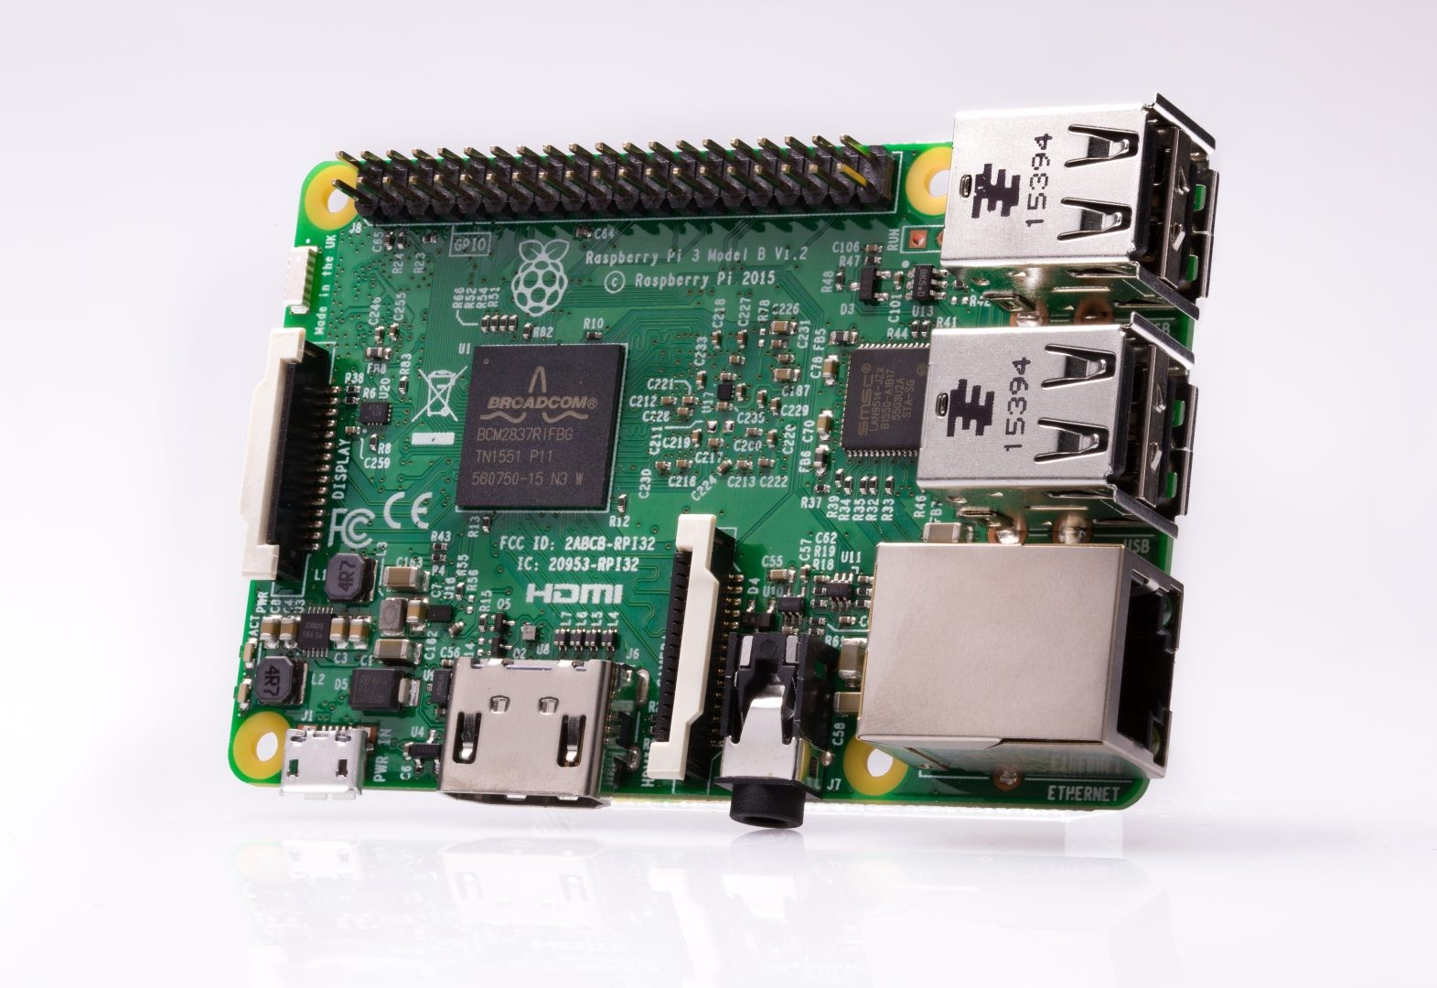
Raspberry Pi 3
Raspberry Pi is a series of small single-board computers developed in the United Kingdom by the Raspberry Pi Foundation to promote the teaching of basic computer science in schools and in developing countries. It is an SoC (System on chip), which integrates all the components of a computer or other electronic systems on a single chip like a GPU, Wifi-Module etc.

Slide 13
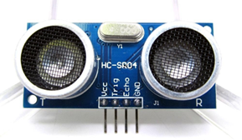
Ultrasonic Sensor (HC-SR04)
The human ear can hear sound frequency around 20HZ ~ 20KHZ, and ultrasonic is the sound wave
beyond the human ability of 20KHZ.[21] HC-SR04 is an ultrasonic ranging module that provides 2 cm
to 400 cm non-contact measurement function. The ranging accuracy can reach to 3mm and effectual angle is < 15°. It can be powered from a 5V power supply.

Slide 14
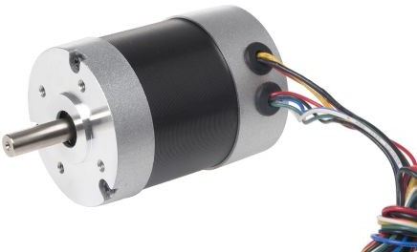
DC MOTOR
A DC motor in simple words is a device that converts electrical energy (direct current system) into mechanical energy. The direction of current is given by the Fleming's Left Hand Rule.

Slide 15
SOFTWARE DETAILS

Slide 16
TENSORFLOW | TensorFlow is an open source software library for high performance numerical computation, originally developed by researchers and engineers from the Google Brain team within Google’s AI organization, it comes with strong support for machine learning and deep learning.
KERAS | Keras is a high-level neural networks API, written in Python and capable of running on top of TensorFlow, CNTK, or Theano, two of the top numerical platforms in that provide the basis for Deep Learning research and development.
PYTHON 3.6.4 | Python is an interpreted high-level programming language for general-purpose programming. It supports multiple programming paradigms, including object-oriented, imperative, functional and procedural, and has a large and comprehensive standard library.

Slide 17
ANACONDA | Anaconda is a free and open source distribution of the Python and R programming languages for data science and machine learning related applications, that aims to simplify package management and deployment.
GITLAB | GitLab is the leading integrated product for modern software development. It connects issue management, version control, code review, CI, CD, and monitors into a single, easy-to-install application which helps teams go faster from planning to monitoring.

Slide 18
OBJECT DETECTION

Slide 19
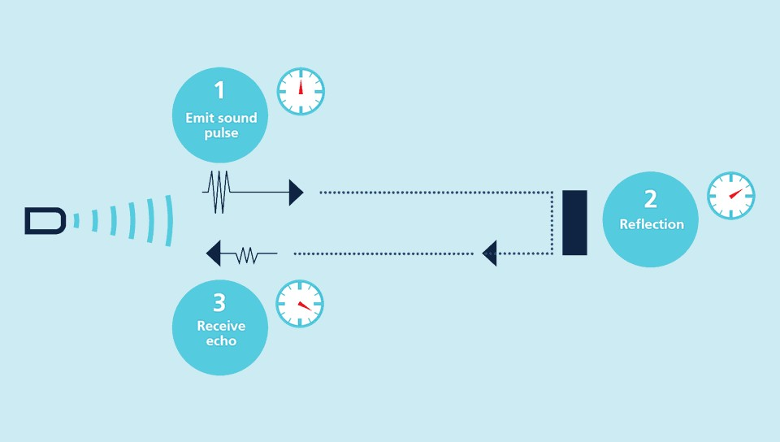
Ultrasonic sensors works on the principle of emitting short, high-frequency sound pulses at regular intervals. These propagate in the air at the velocity of sound. If they strike an object, then they are reflected back as echo signals to the sensor, which itself computes the distance to the target based on the time-span between emitting the signal and receiving the echo. As the distance to an object is determined by measuring the time of flight and not by the intensity of the sound, ultrasonic sensors are excellent at suppressing background interference. Virtually all materials which reflect sound can be detected, regardless of their color. Even transparent materials or thin foils represent no problem for an ultrasonic sensor.
When a vehicle approaches the entry barrier, its presence is detected using an ultrasonic sensor. The ultrasonic sensor intimates the processor of the presence of the vehicle which then turns on the camera. The camera captures the image of the vehicle and that image is then used to recognize license plate detection and vehicle classification.

Slide 20
License plate detection

Slide 21
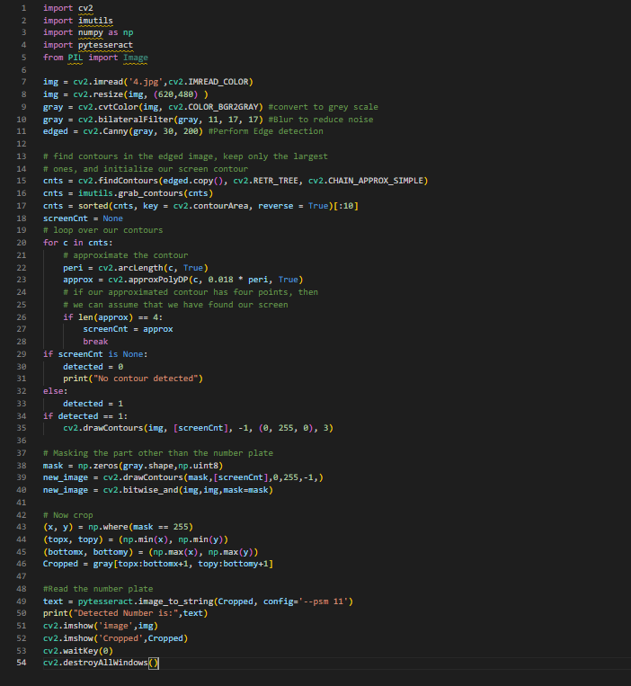
License Plate Recognition uses the concepts of Digital image Processing and Optical Character Recognition to extract the registered vehicle number from the license plate. This procedure is divided into two steps:
Plate Detection
Character Detection in Plates

Slide 22
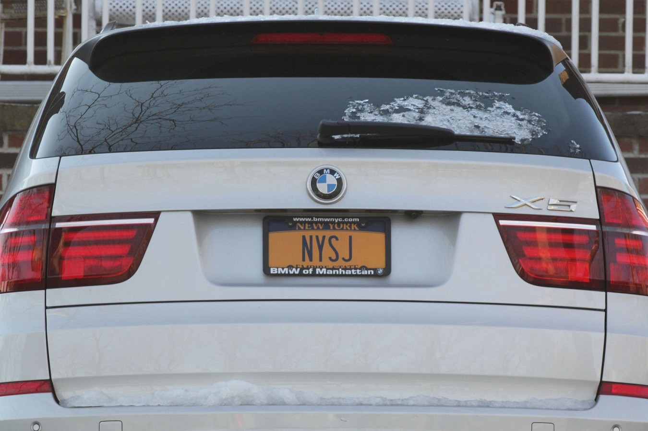
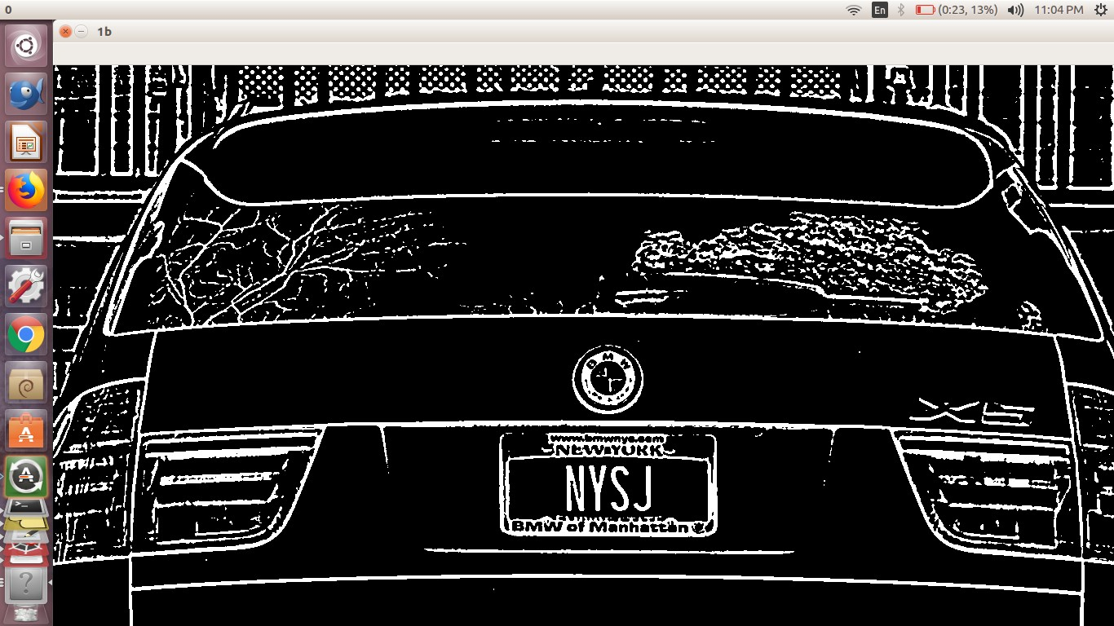
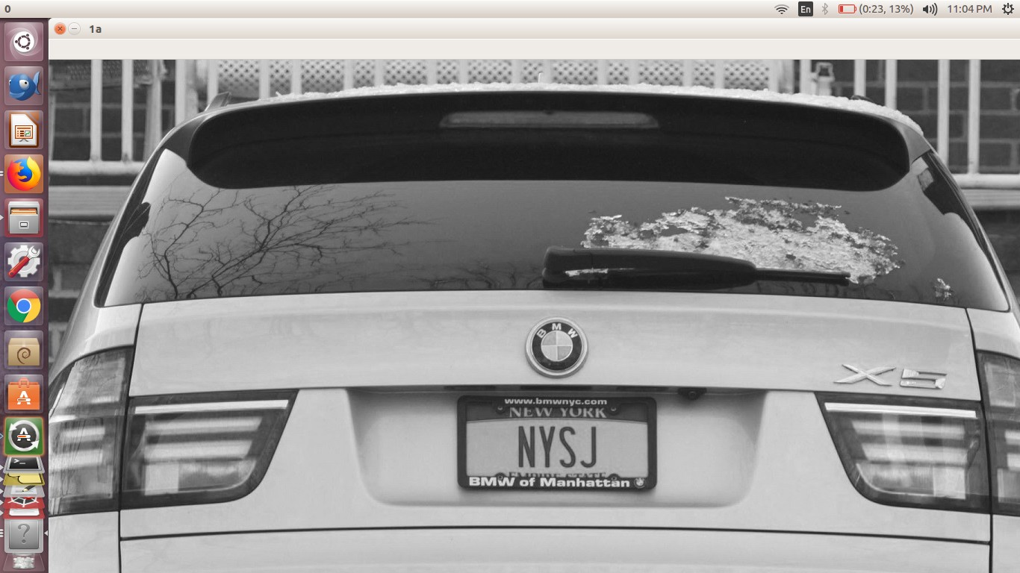
Plate detection
Image Of Car Captured From Camera
RGB Image Converted to Grayscale
Image Converted to Binary

Slide 23
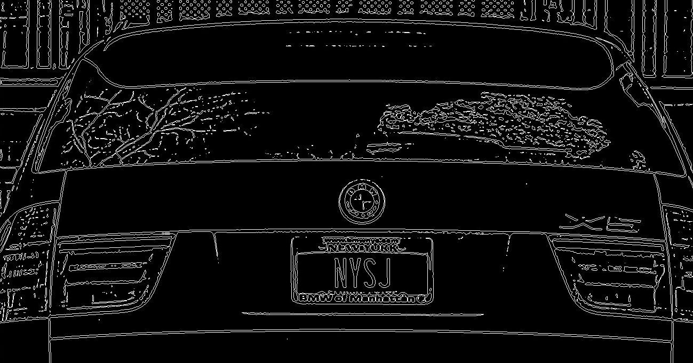
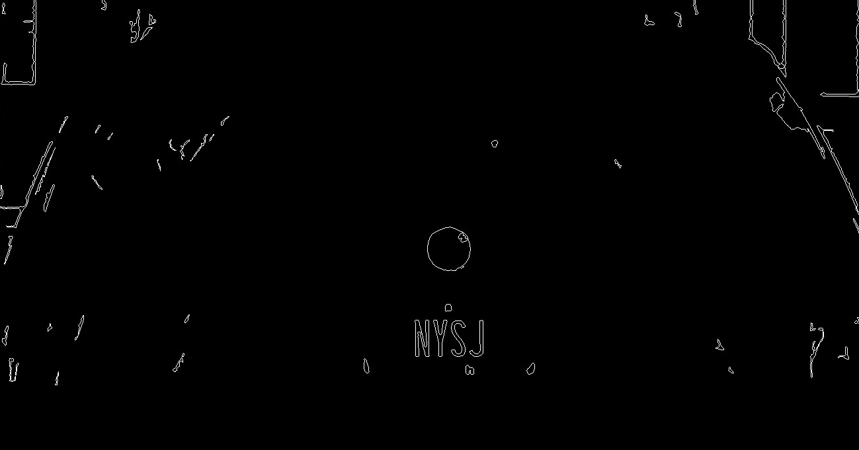
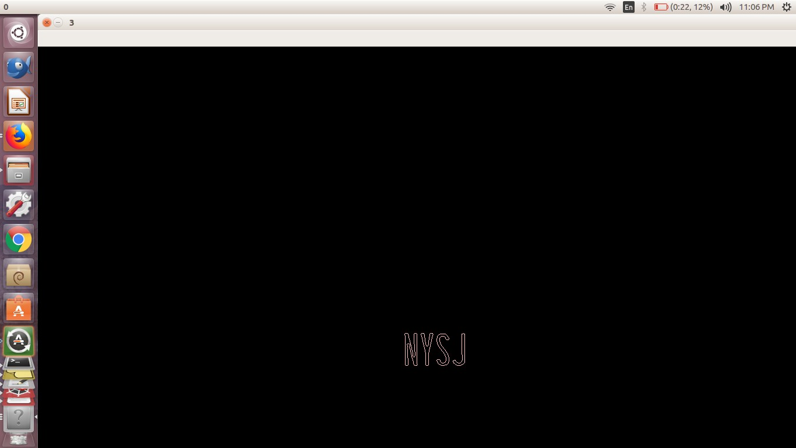
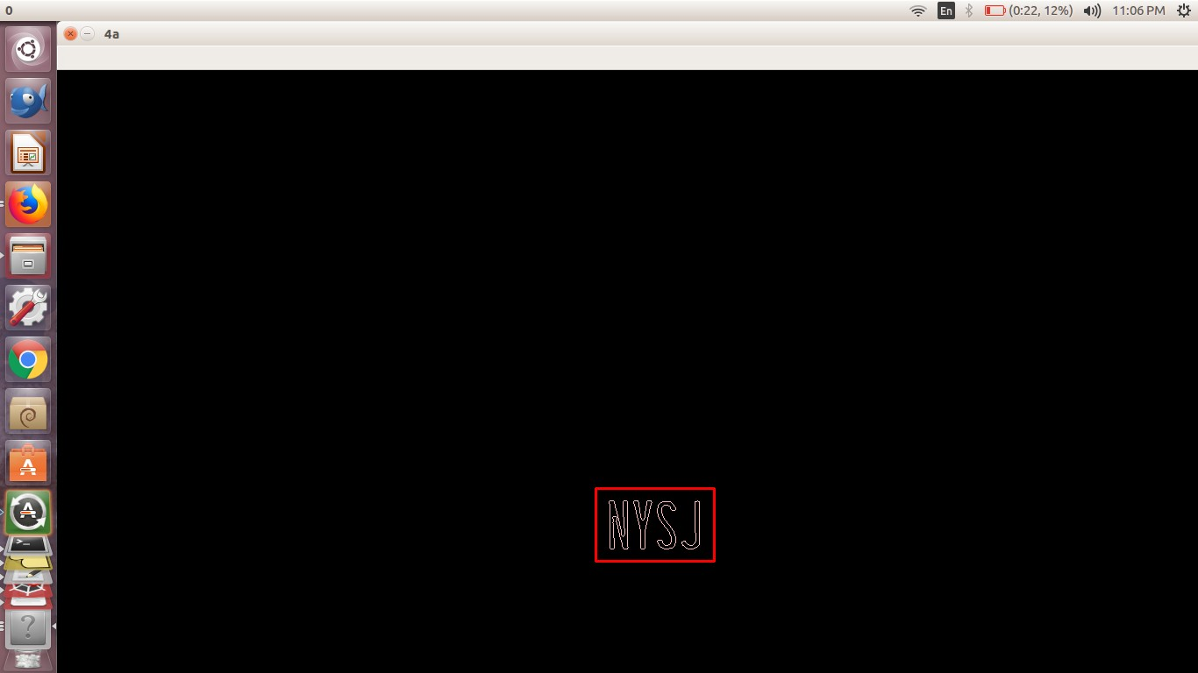
Contours Drawn Around Connected Regions
Possible Characters Found
Number Plate Identified
Extracted Number Plate

Slide 24
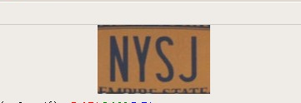
Cropped Number Plate from Original RGB image

Slide 25
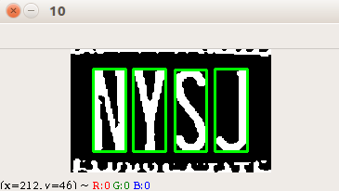
Character detection in plates
All possible plates are resized for the purpose of clarity and preprocessed. The image is inverted, converted to gray scale and then into binary by thresholding. Possible characters are detected as in the case of plate detection following the exact same steps.
After generating the ListofListsofMatchingCharactersinPlate, the overlapping characters are removed. The longest length of matching chars is chosen to be the actual licence plate. The characters are recognized using KNN (K Nearest Neighbor) classification model.

Slide 26
VEHICLE CLASSIFICATION

Slide 27
Vehicle classification is performed using Convolutional Neural Networks( CNN or ConvNets) which are a special kind of multi-layer neural networks. Convolutional Neural Networks are designed to recognize visual patterns directly from pixel images with minimal preprocessing.
We have used pretrained Residual Network deep learning architecture and then fine-tuned the network to fit our dataset of images of Cars and Bikes.

Slide 28
Convolutional Neural Network

Slide 29
Convolutional Neural Networks take advantage of the fact that the input consists of images and they constrain the architecture accordingly[2]. Unlike a regular Neural Network, the layers of a ConvNet have neurons arranged in 3 dimensions: width, height, depth. Moreover, the neurons in a layer will only be connected to a small region of the layer before it, instead of all of the neurons in a fully-connected manner[2]. Basically, a ConvNet is made up of Layers. Every Layer has a simple API: It transforms an input 3D volume to an output 3D volume with some differentiable function that may or may not have parameters[2].

Slide 30
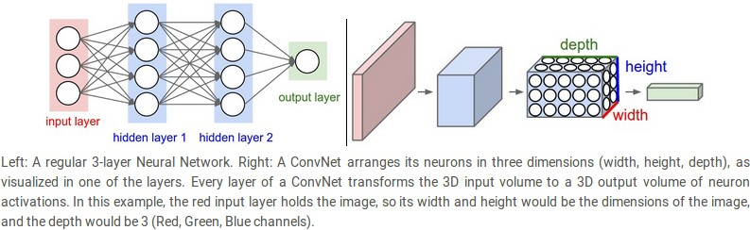
Neural Network and Convolutional Neural Network [2] .

Slide 31
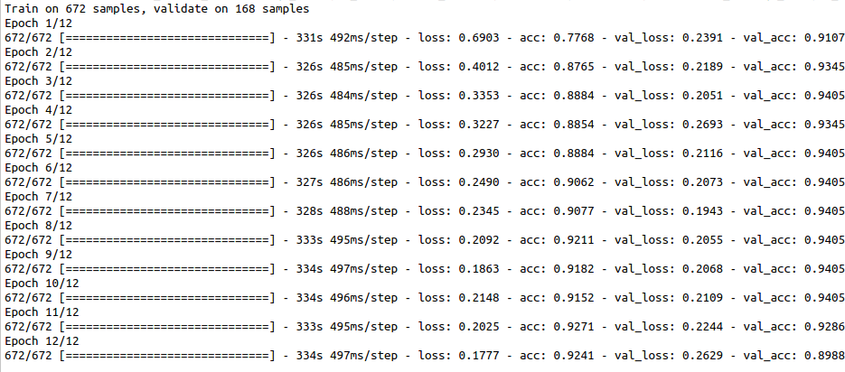
Screenshot of training done for Vehicle Classification

Slide 32
DATABASE MANAGEMENT

Slide 33
Csv (Comma Separated Values) file is used to store the following information:
1. Number Plate of the vehicle
2. Type of Vehicle (Car or Bike)
3. Entry Time of the vehicle
As soon as a new number plate is detected, all the above information is stored in the database of the Parking system and whenever an existing number plate is recognized, the fare is calculated on the basis of exit time and all the information regarding the vehicle is removed from the database. This is implemented using Pandas in Python.

Slide 34
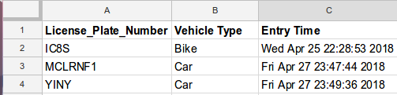
Snapshot of FaraCalculation.csv file

Slide 35
IMPLEMENTATION

Slide 36
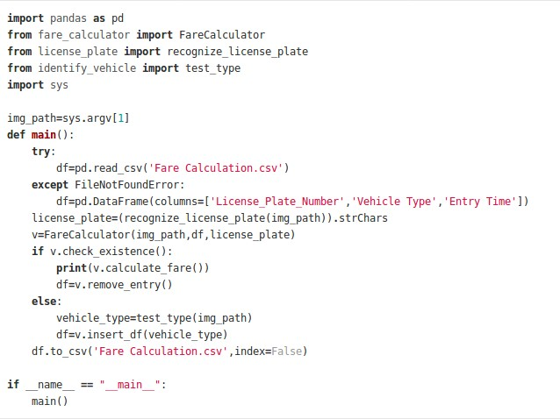
Code Snippet of main.py

Slide 37
As soon as ultrasonic sensor detects the object, camera clicks the image and that image is passed as argument to the ‘main’ function shown above.
● The main function opens the database of the vehicles or creates one if one doesn’t exist already.
● The license plate is recognized and stored in variable license_plate
● An object of class FareCalculator is created.
● Image, dataframe and license plate are the members of class which get instantiated upon making of the object.

Slide 38
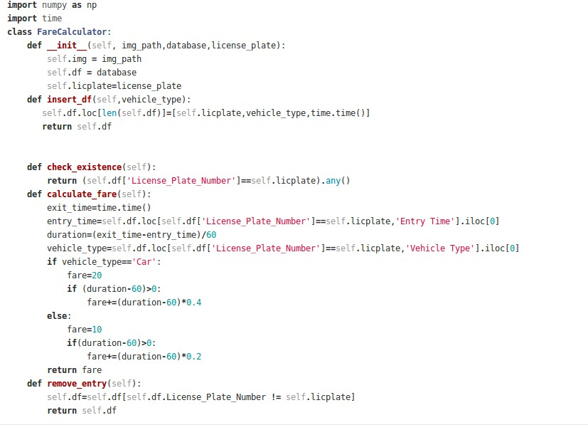
Code snippet of FareCalculator class

Slide 39
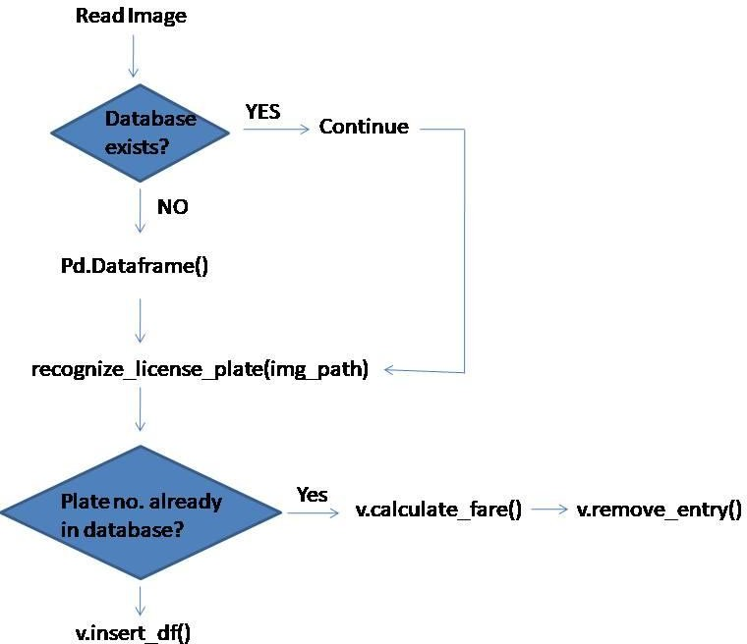
Code Flow

Slide 40
RESULT
A complete study of the survey papers revealed various new technologies used in Automatic Fare Generation which included convolutional neural network , Image pre-processing , You look only once algorithm AI , Self Organizing MAP etc. Further detailed analysis of those papers revealed some gaps which could be covered in our project. Automatic fare generation system proposed by us makes use of hardware components such as Raspberry Pi 3, Ultrasonic Sensor (HC-SR04), DC Motor which we have configured so far. The Automatic fare generation system will also be using some software as analyzed by us till now which include Tensor Flow, Keras, Anaconda, GIT Lab. Besides this we will also be using Python libraries extensively to make our project efficient and solve problems algorithmically. An analytical approach towards the project reveals us that it would engage Computer Vision and Machine Learning tools too.

Slide 41
conclusion
An efficient and time saving parking system can be created with an Automatic Fare Generation System. As the world treads the path of Artificial Intelligence, renovating the systems to make them as human management independent as possible has utmost importance. An automatic system thus not only pave way for a hassle free fare generation but increases the overall efficiency thus saving time and money of the users.

Slide 42
Future scope
The project can be extended to develop an app to convert traditional parking spaces into a smart parking lot. The app functionality will include:
Each user can have an account with single or multiple license plates registered
Machine learning can further be deployed to give discount to the users on the basis of their usage of that particular parking lot.
By linking Aadhar/syncing account info fare can be automatically deducted.

Slide 43
THANK YOU

